Slide 1


WEEK OF LEARNING
WEBATHON
18/05 | M S Ramaiah Institute of Technology

Slide 2
Welcome!

Slide 3

Progate Vision

Slide 4
Week of Learning
DAY 0
MEETUP
DAY 1
DAY 7
DAY 8
MEETUP
WEBATHON
Kickstart your Web Development Journey
Try your hands on HTML, CSS & JavaScript by making
a project.
Build your own project and get
a chance to win exciting prizes!
Get
Charged
Learn Fundamentals of HTML, CSS & JavaScript on Progate
TODAY!!

Slide 5


WEBATHON THEME
“Real time landing page based on a QR code”
Hello World!
Notes:
Let them know that they can start learning the first lesson of HTML&CSS right away!

Slide 6
Rules for participants
All students who’ve attended the Week of Learning Day 8 Meetup are eligible. Participants should have already learned the fundamentals of HTML & CSS and JavaScript ES6 on Progate.
We encourage you to participate individually
After submitting the project, you will give a presentation.

Slide 7
Rules for participants
Submit your projects latest by 3 PM here:
bit.ly/weekoflearningprogatesubmission
Once done, you can learn how to publish your
own website on GitHub -
progate.com/docs/github-pages

Slide 8
Judging Criteria
Implementation of HTML, CSS and JavaScript concepts:
10 Points
Creativity:
5 Points
Usefulness:
5 Points
Tie Breaker:
Documentation and Presentation (5 Points)

Slide 9
Today’s Schedule
10.00 AM - 11.30 PM: Webathon
11.30 AM - 11:45 AM:Break
11:45 AM - 1PM: Students Demo
1.30 PM: Winners Announcement and Close

Slide 10



Here are some tips
Upload all your project files in a public
GitHub repository
Provide a brief description with screenshots
in the README.md file or a MS Word file uploaded in the same repository
Don’t worry about making it perfect.
Follow 80% rule.
01
02
03
Notes:
We have some tips for you as you start the Week of Learning

Slide 11



Webathon Prizes
1

Slide 12
How’s the Josh?

Slide 13
DEMO

Slide 14
3rd Prize Winner
Notes:
We have some tips for you as you start the Week of Learning

Slide 15
3rd Prize Winner
NAME 🎉
Notes:
We have some tips for you as you start the Week of Learning

Slide 16
2nd Prize Winner
Notes:
We have some tips for you as you start the Week of Learning

Slide 17
2nd Prize Winner
NAME🏆
Notes:
We have some tips for you as you start the Week of Learning

Slide 18
1st Prize Winner
Notes:
We have some tips for you as you start the Week of Learning

Slide 19
1st Prize Winner
NAME 🥳
Notes:
We have some tips for you as you start the Week of Learning

Slide 20
Share the certificate!
Make your resume stellar by earning a certificate!
This certificate proves that you have a fundamental skill of web development. For the next step, upload and share the cerficiate on LinkedIn to show you are an independent web developer!
Announcements
STEP 1
Upload your certificate on LinkedIn!
STEP 2
Share your certificate on LinkedIn!
Notes:
Make your resume stellar by earning a Progate Week of Learning certificate! All participants who complete the Week of Learning from Day 1 to Day 8 and submit their project in Webathon will be awarded certificates.
This proves you have great coding skills!

Slide 21
Next Steps to Learn More

Slide 22

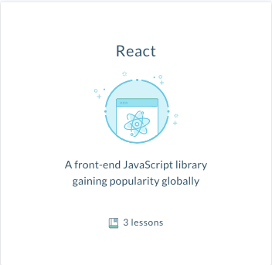
Next steps to learn more
Learn server side technology(Node.js). You will be able to store and handle the data.
Learn front end framework(React.js). You will be able to learn to make a front end in an effective way.
You can learn both technology on Progate! Learn Now 🔥

Slide 23
WEEK OF LEARNING
WEBATHON
18/05 | M S Ramaiah Institute of Technology

